Slide 1
IMAGE COMPRESSION USING HUFFMAN CODING-DAVID HUFFMAN.
Course: Data Structures-ce386
Group Members
[Name]
[name]
[name]

Slide 2
Flowchart for Huffman encoding algorithm
Start
Receive Input Image Array
Calculate Frequencies of Pixel Values
Create Initial Nodes for Each Unique Pixel Value
Sort Nodes by Frequency
Build Huffman Tree
Create Internal Node with Two Smallest Nodes
Insert Internal Node Back into List
Generate Huffman Codes
Display Results
Exit or Compress Another Image?
Exit
End
Create Internal Node with Two Smallest Nodes

Slide 3
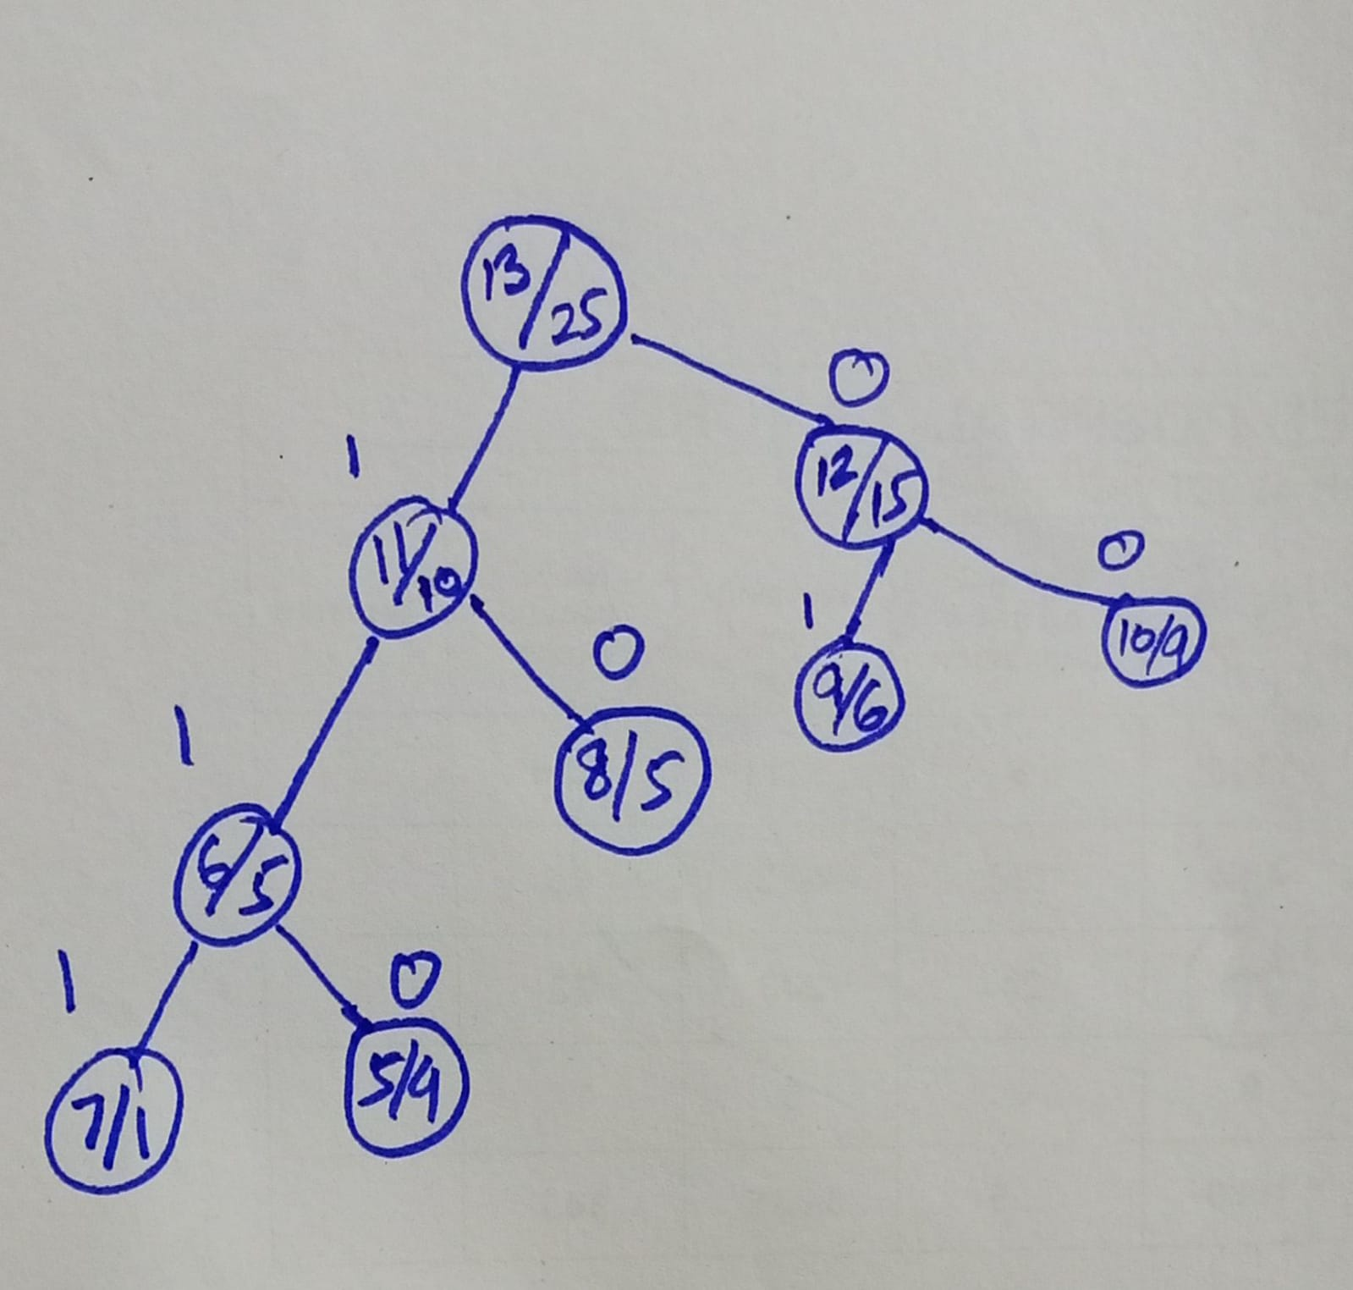
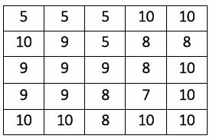
Solution to Appendix-A: I1
Huffman
Tree
Pixel Intensity Value | Frequency
7 | 1
8 | 5
9 | 6
10 | 9
5 | 4
The uncompressed image will take 5 x 5 x 8 = 200 bits of storage. Table-1: Pixel Intensity Value and Frequency

Slide 4
Result:
Pixel Intensity Value | Frequency | Code-word | Size
10 | 9 | 00 | 9*2
9 | 6 | 01 | 6*2
8 | 5 | 10 | 5*2
5 | 4 | 110 | 4*3
7 | 1 | 111 | 1*3
Finally, the 200-bit image will be compressed to 9x2 + 6x2 + 5x2 + 4x3 + 1x3 = 55 bits, which is about 6 bytes compared to 36 bytes in the original image. And the height of tree is 4
Table-2: Huffman Codes and Sizes

Slide 5
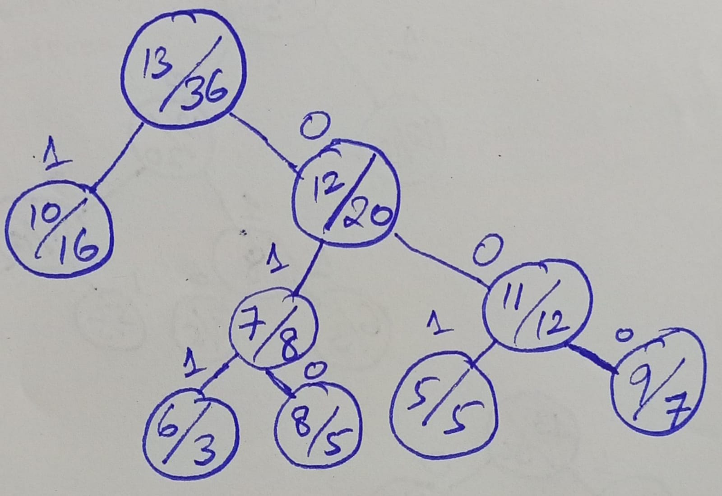
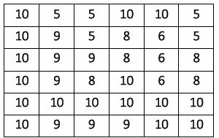
Solution to Appendix-A: I2
Huffman
Tree
Pixel Intensity Value | Frequency
6 | 3
8 | 5
9 | 7
5 | 5
10 | 16
The uncompressed image will take 6 x 6 x 8 = 288 bits of storage. Table-1: Pixel Intensity Value and Frequency

Slide 6
Result:
Pixel Intensity Value | Frequency | Code-word | Size
10 | 16 | 1 | 16*1
9 | 7 | 000 | 7*3
5 | 5 | 001 | 5*3
8 | 5 | 010 | 5*3
6 | 3 | 011 | 3*3
Finally, the 200-bit image will be compressed to 16x1 + 7x3 + 5x3 + 5x3 + 3x3 = 76 bits, which is about 5 bytes compared to 25 bytes in the original image. And the height of tree is 4
Table-2: Huffman Codes and Sizes

Slide 7
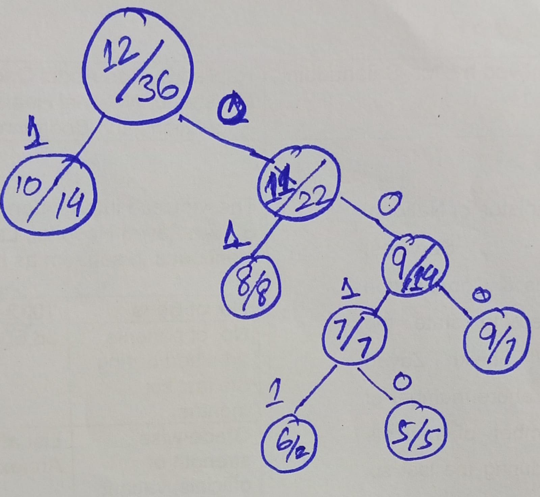
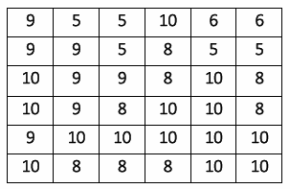
Solution to Appendix-A: I3
Huffman
Tree
Pixel Intensity Value | Frequency
8 | 8
6 | 2
10 | 14
5 | 5
9 | 7
The uncompressed image will take 6 x 6 x 8 = 288 bits of storage. Table-1: Pixel Intensity Value and Frequency

Slide 8
Result:
Pixel Intensity Value | Frequency | Code-word | Size
10 | 14 | 1 | 14*1
8 | 8 | 01 | 8*2
9 | 7 | 000 | 7*3
5 | 5 | 0010 | 5*4
6 | 2 | 0011 | 2*4
Finally, the 200-bit image will be compressed to = 79 bits, which is about 6 bytes compared to 36 bytes in the original image. And the height of tree is 5
Table-2: Huffman Codes and Sizes

